Slide 1

Financial Forecasting Dashboard
Sales Performance Overview for 2013 - 2014
Prepared by
Sahana S

Slide 2
Power BI
Power BI is a powerful business analytics tool developed by Microsoft that enables users to connect, visualize, and analyze data from multiple sources. It’s designed for creating interactive dashboards, reports, and visualizations, making it easier for organizations and individuals to uncover actionable insights.
Components of Power BI
Key Features of Power BI
Power BI Desktop
Power BI Service
Power BI Mobile
Power BI Gateway
Power Query
Power BI Embedded
Data connectivity
Interactive Dashboards and Reports
Data transformation
Custom visualization
Seamless Integration
AI-Powered Insights

Slide 3
Benefits of Power BI
Ease of Use: Drag-and-drop functionality, no coding required for basic tasks.
Cost-Effective: Affordable licensing options for individuals and organizations.
Collaboration: Teams can share and collaborate on reports in real-time.
Scalability: Suitable for small businesses to large enterprises.
Data Security: Built-in encryption and compliance with industry standards.

Slide 4
Financial Forecasting
Financial Forecasting is the process of estimating future financial outcomes by analyzing historical data, economic trends, and market conditions. It is a critical tool for businesses to plan budgets, manage cash flows, assess risks, and make informed strategic decisions.
Types
Components
Revenue Forecasting
Expense Forecasting
Cash Flow Forecasting
Profit Forecasting
Historical Data
Key Assumption
Financial Models
Software Tools
Validation and Adjustments

Slide 5
.
Key Techniques in Power BI for Financial Forecasting
1. Trend Analysis
Analyze historical trends using time-series visualizations.
Identify seasonal patterns and growth trends.
2. Variance Analysis
Compare actual financials with forecasts to measure deviations.
3. Budgeting and Planning
Incorporate budgets and planned values alongside forecasts for comprehensive insights
Benefits of Financial Forecasting
Improved Decision-Making: Provides data-driven insights for strategic planning.
Risk Management: Identifies potential financial challenges and allows proactive responses.
Resource Allocation: Optimizes budgets and investments based on predicted outcomes.
Stakeholder Confidence: Demonstrates foresight and planning to investors, lenders, and stakeholders.

Slide 6
Project Overview
To analyze and visualize key sales metrics to support data-driven decision-making.
Key Focus Area
Sales performance over time
Profitability by country, segment, and product
Discount trends and impact on profits

Slide 7



Workflow
Data Collection and Loading
Data Cleaning and Transformation
Data Storage and Management
Data Analysis and Insights

Slide 8



Project Objectives
Analysis Phase
Strategy Development
Implementation Plan
Examining sales, orders, profit, and discounts across regions, products, and segments to identify trends and areas for improvement.
Generating actionable insights, such as optimizing discounts, focusing on high-performing regions/products, and addressing underperforming segments.
Building an interactive Power BI dashboard to visualize key metrics, track KPIs, and provide stakeholders with tools to guide strategic decisions.

Slide 9

Methodology

Slide 10
1. Data Collection and Preparation:
Gathered raw sales and financial data from multiple sources.
Performed data cleaning and preprocessing to ensure accuracy and consistency using tools like Excel and SQL.
2. Exploratory Data Analysis (EDA):
Analyzed key metrics such as sales, orders, profit, and discounts across time, regions, products, and segments.
Identified trends, patterns, and outliers to understand data behavior.
3. Data Modelling and Transformation:
Created calculated fields (e.g., profit margin, discount percentages) to support deeper analysis.

Slide 11
4. Data Visualization:
Designed an interactive dashboard in Power BI to present insights visually.
Used charts, tables, and filters for better stakeholder engagement and understanding.
5. Performance Metrics Evaluation:
Tracked KPIs such as total sales, profit percentage, and order volumes to evaluate business performance.
6. Insights Generation and Strategy Development:
Generated actionable insights for optimizing pricing, enhancing profitability, and focusing on high-performing regions and products.

Slide 12

Data
Analysis

Slide 13
Key Performance Indicators
Key Sales and Financial Metric
Sales: 92.31M (+240.49% YoY)
The total sales was 26.42 M in 2013 and it is increased by 240% in 2014.
Orders: 861,132 (+225.36% YoY)
The total unit sold is increased from 264,674 units in 2013 to 861,132 in 2014
Profit: 13.02M (+235.58% YoY)
Shows a total profit of 13.02 million, a 235.58% increase compared to the previous year
Profit %: 14.10% (down slightly from 14.68% last year)
Displays a current profit margin of 14.10%, slightly down from the previous year’s 14.68%.
Discount: 7.06M (+220.04% YoY)
The total discount is 7.06 million, which marks a 220.04% increase over the prior year.

Slide 14
Total Orders by Country

Slide 15
Profit% by Country

Slide 16
Discount% by Discount

Slide 17
Profit% by Segment

Slide 18
Sales Trends over time

Slide 19
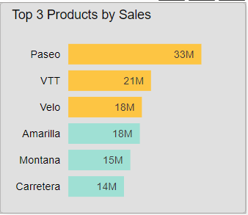
Top Selling Products

Slide 20
Sales Performance
Analysis

Slide 21

Current Sales Trends:
Top Performing Regions:
The total sales for the current period stand at 92.31 million, showing a substantial year-over-year increase of 249.46%. This indicates a strong upward trend in sales performance, suggesting effective sales strategies and increased demand.
Canada and France lead in order volume, with 247K and 241K orders respectively, followed closely by the United States with 233K orders. These countries are key contributors to overall sales, and further efforts in these regions could amplify growth.
Profitability:
Order Volume Growth
The current profit margin is 14.10%, slightly down from 14.68% in the previous year. Despite the overall sales growth, the marginal decline in profit percentage suggests that either increased costs or higher discounting may be impacting profitability.
The total number of orders has reached 861,132, representing a significant increase of 225.36% from the previous year. This rise in order volume aligns with the growth in sales revenue and highlights successful customer acquisition or retention efforts.

Slide 22


Sales Distribution by Product:
Monthly Sale Trend
The top three products—Paseo (33M in sales), VTT (21M), and Velo (18M)—are driving a significant portion of revenue. These products appear to be customer favorites and could be strategically prioritized in marketing or sales campaigns
The sales trend over the year shows some fluctuations, suggesting potential seasonality. The highest peaks in sales might correspond to key shopping seasons or promotional periods, which could be leveraged in future campaigns.
Opportunity for Improvement
Discount Analysis:
While sales and orders are growing, the slight decline in profit margin points to an opportunity to optimize pricing or discount strategies. Additionally, focusing on high-profit regions and segments could further enhance overall profitability
The total discount amount stands at 7.06 million, marking a 220.04% increase over the prior year. The majority of discounts fall into the High category (57.76%), which, while encouraging sales, might be affecting the overall profit margin.

Slide 23
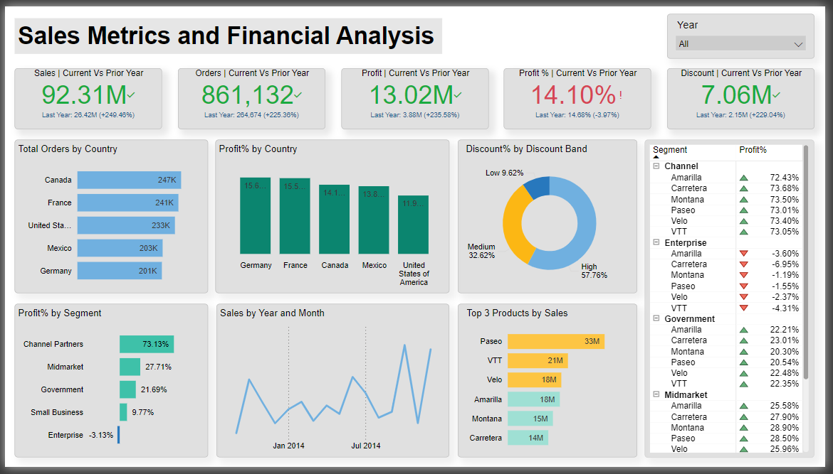

Slide 24
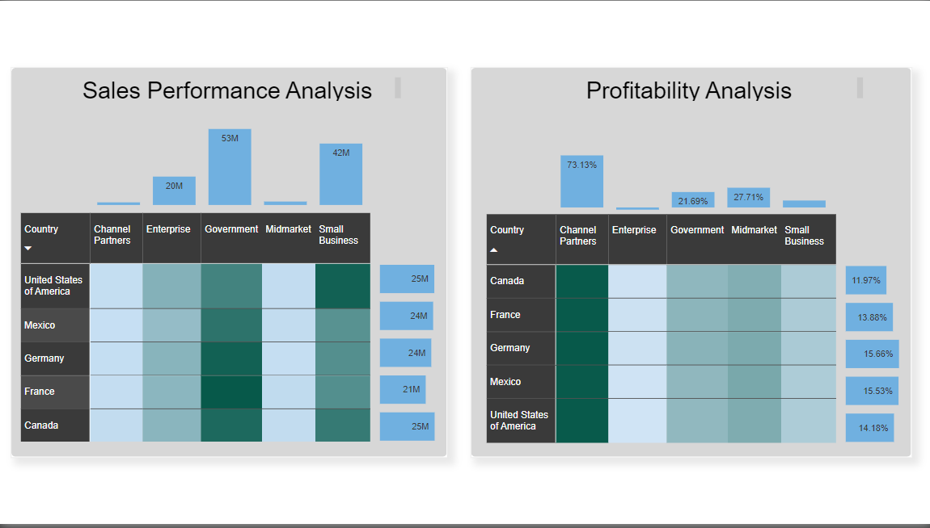

Slide 25
Conclusion
The Sales Metrics and Financial Analysis Dashboard successfully provides a comprehensive view of key sales and financial metrics, empowering stakeholders to make informed decisions. By analyzing trends in sales, profit, discounts, and product performance, the dashboard identifies opportunities for growth and areas needing improvement.
Key takeaways include:
Significant year-over-year growth in sales and orders.
High-performing regions and products driving revenue.
Opportunities to optimize discount strategies and improve low-performing segments.

Slide 26
Thank you

